Slide 1
ULI101: Introduction to Unix / Linux and the Internet Week1: lesson 1 Course Introduction / Unix and Linux Background ACCESSING YOUR Linux Matrix server account
Photos and icons used in this slide show are licensed under CC BY-SA

Slide 2
Lesson 1 topics
Why I Am Taking This Course? (Course Introduction)
Instructor Information / Purpose of Course
Foundations For Future Courses (Programming, Networking)
Course Resources / Course Outline (Course Evaluation) / Course Policies
Background and Features of UNIX and LINUX OS
Purpose of an OS / History of Unix & Linux OS
Features of Unix / Linux OS
Matrix Linux Server
Purpose / Layout
How to Access your Matrix Linux Account:
From Home (Windows, Mac OSX, Linux) / From Seneca Computer Lab (Via MyApps)
How to Logout of your Matrix Linux Account / Getting Assistance (ITS HelpDesk)
Homework
Perform Tutorial 1 – Investigation #1

Slide 3

Course Introduction
Why Am I Taking This Course?
Regardless of the IT program that you are currently registered in, there are important technical skills that you must learn in order to be successful in future courses for your program.
In this course, you will learn core utilities to work productively in a Unix / Linux operating system environment including the following topics:
Issuing Linux commands and utilities
Manipulating data stored in regular text files
Managing files and directories (including access & permissions)
Writing basic shell scripts
Configuring login accounts

Slide 4

Course Introduction
Foundation for Future Courses
The following table shows the various courses that require Linux skills for the networking & tech support / programming streams.
Networking / Tech Support Stream | Programming Stream
OPS245 (Intro to Linux Admin) OPS345 (Network Admin) OPS435 (Linux Admin Automation) CSN500 (Capstone Project, formerly NDD430) OPS535 (Advanced Network Admin) OPS635 (Enterprise Management) + Pro-Option Courses | IPC144 (Intro to Programming) OOP244 (Object Oriented Programming I) OOP345 (Object Oriented Programming II) WEB322 (Web Programming Tools) WEB422 (Web Programming Apps & Services) JAC444 (Intro to Java) + Pro-Option Courses

Slide 5

Course Introduction
Course Resources The following table shows resources that students can use to learn topics for this course. The first two resources are considered critical for successful course completion.
Resources | Purpose
Blackboard (Learning Content Management System) https://my.senecacollege.ca/ | Course Marks (located in My Grades) Link to the ULI101 WIKI Online Quizzes / Online Tests
ULI101 WIKI: https://wiki.cdot.senecacollege.ca/wiki/ULI101 | Course Outline / Course Policies Weekly Schedule Course notes, Tutorials (weekly, review) Practice questions
The Linux Documentation Project http://en.tldp.org/ | Vast online Linux Documentation HOWTOs, Guides, FAQs

Slide 6

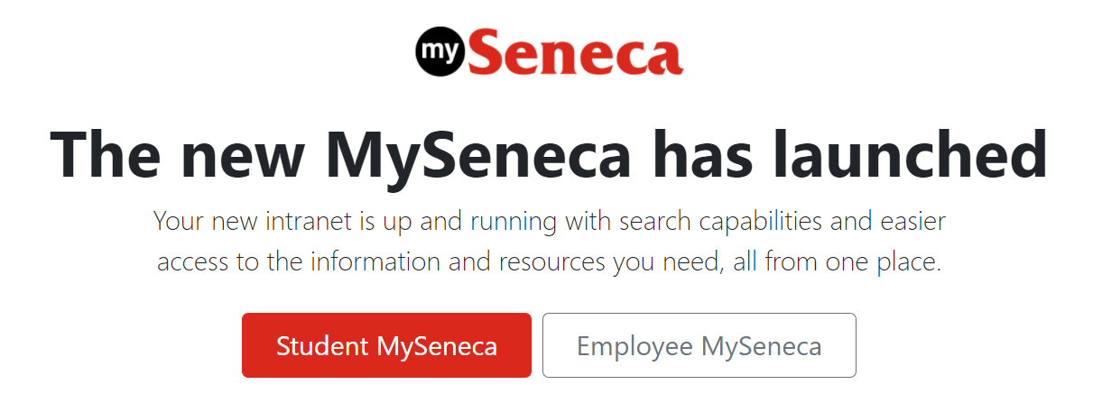
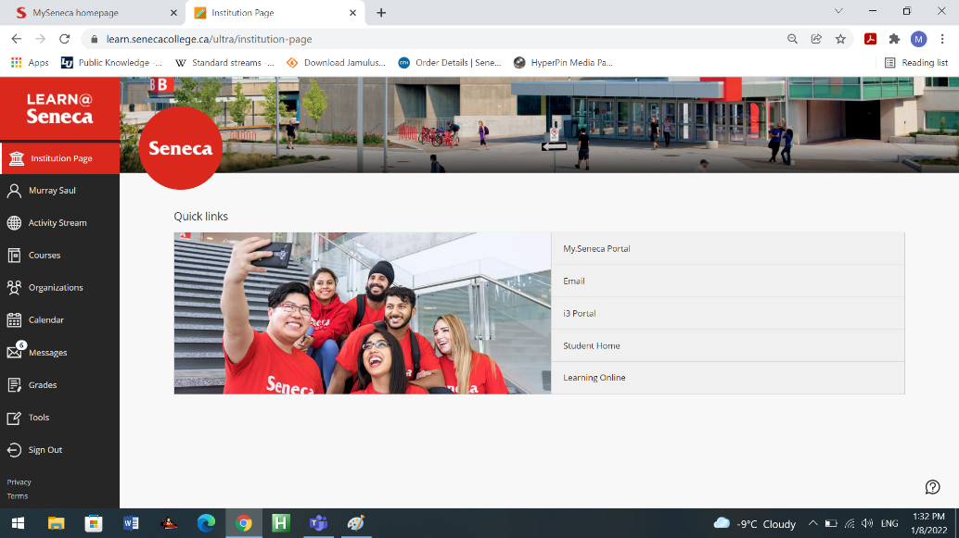
Course Introduction
Blackboard
The Blackboard online application is used to view notes and recorded lectures, perform optional online tutorials, perform tests and quizzes. To access course materials in Blackboard:
Enter the following in a web-browser: my.senecacollege.ca
Click Student MySeneca
Click Learn@Seneca tab
Enter your username and password (You should have been provided a username and password to gain access to this resource)

Slide 7
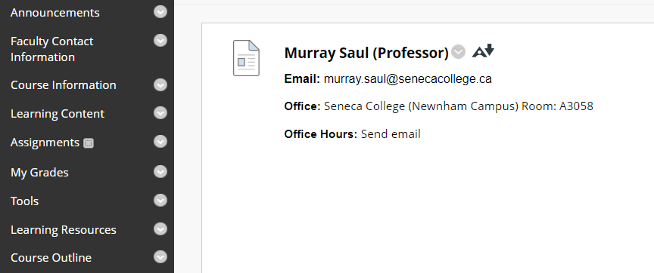
Course Introduction
Faculty Information
Please note and record the following information in class (Select Faculty Contact Information from left navigation pane):
Instructor’s Full Name
Instructor’s Office Location
How to Contact ULI101 Instructor:
E-mail Address
Video Classes / Meetings (eg. MS Teams, Zoom, etc)

Slide 8
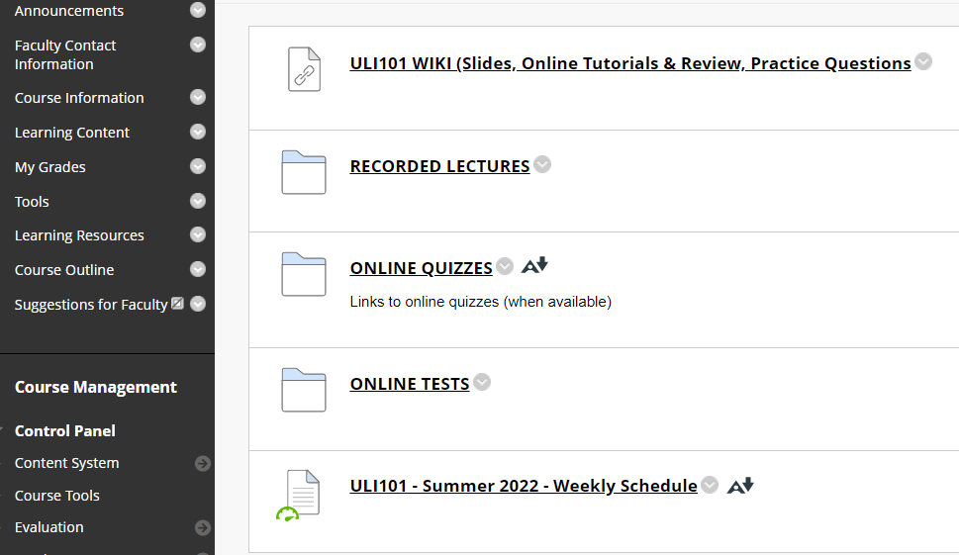
Course Introduction
Blackboard: Learning Content In the Learning Content section of your Blackboard ULI101 course, there are several resources which might include:
A Link to the ULI101 WIKI that contains weekly lesson slides and hands-on tutorials.
Recorded Lectures are recorded live and saved as a streaming video which becomes available a few hours after the lecture.
Online Quizzes contain online quizzes for this course.
Online Tests contain the midterm (test1) and final exam (test2) for this course.
Weekly Schedule displaying weekly content and due dates for evaluation.

Slide 9
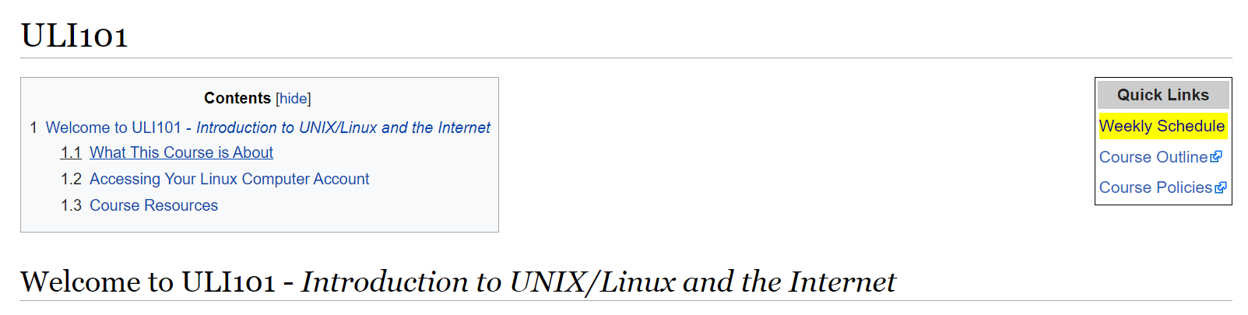
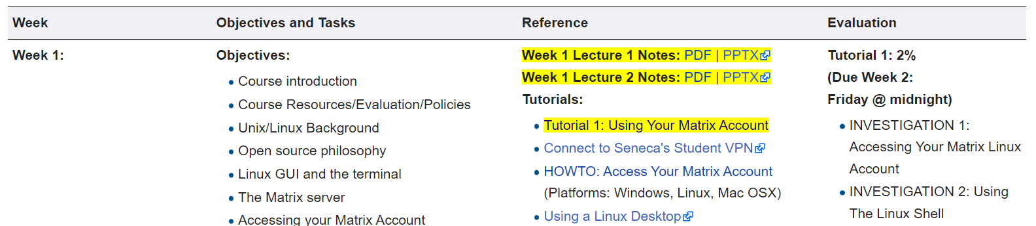
Course Introduction
ULI101 WIKI
Main WIKI Page
The Quick Links section on the top-right corner (in yellow) provide links to the weekly schedule, course outline, and course policies.
Weekly Schedule Page
The weekly Schedule cans weekly lecture notes (in yellow) in both PDF and PowerPoint format.
The Tutorials section (in yellow) contains a weekly hands-on tutorial that provide the student-guided practice to become familiar with working in the Linux environment. These tutorials require successfully completion within a deadline to obtain marks.
NOTE: It is REQUIRED to perform there areas that are highlighted in yellow.

Slide 10

Course Introduction
Course Outline
Link: https://apps.senecacollege.ca/ssos/findOutline.do?schoolCode=SICT&termCode=20222&subjectCode=ULI101
Topics
Course Description
Modes of Instruction
Evaluation / Promotion Policy
Learning Outcomes / Topic Outline

Slide 11

Course Introduction
Course Policies
Link: https://wiki.cdot.senecacollege.ca/wiki/Course_Policies_for_ULI101
Topics
Online Tutorials (weekly and review)
Quizzes, Midterm Test, and Examination
Cheating & Plagiarism
What constitutes cheating?
General Information

Slide 12
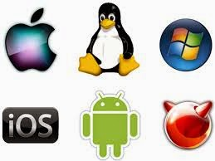
UNIX and LINUX Background and features
Purpose of an Operating System
An operating system basically performs 2 major tasks:
Manages Resources to provide a platform for application to run
Provides an Interface to allow the OS to communicate with the end-user (Humans)
Over time, operating systems used a command line interface, then evolved into a menu-driven interface, then finally a graphical user interface (GUI).
Depending on the OS installation setup, modern operating systems can provide ALL of the above-named types of interfaces to help accommodate all users’ preferences.

Slide 13

UNIX and LINUX Background and features
History of Unix
Although Unix was not the first operating system, it made a huge impact in the 70’s and is still a popular OS today.
Interesting Facts:
The UNIX OS was developed in the early 70’s by Ken Thompson as a platform to play a crude network strategy-based game called “space travel”.
UNIX was developed at AT&T Bell labs, but it took the company a few years to realize that this OS would be popular and marketed proprietary version that became Unix System V (release 4).
While Ken Thompson took a break from work and taught at University of Berkley California, he provided students source code to OS and Shell (interface) which branched into a free version of the OS that became BSD (Berkley Software Distribution) Unix.

Slide 14
UNIX and LINUX Background and features
History of Unix / Continued…
Unix was developed to incorporate the following features:
Allows for multiple users – this is performed by assigning each user a “small slice of time” to give illusion that computer is paying total attention to that user.
Allows for multi-tasking – allows for more than one task to be executed at the same time (e.g. via a “time-slice”).
Supports multi-processing (allows tasks to be performed on multiple processors).
Simplifies sharing of data and programs among users.
Unix also evolved at the time that ARPANET (an ancestor to the Internet) was evolving which made it easier to setup computer networks and use networking and eventually Internet related utilities.

Slide 15
UNIX and LINUX Background and features
History of Unix / Continued…
There are other factors that lead to the popularity of using Unix including:
Unix was re-written using the C programming language to make the OS more portable to install and operated on other types of computers.
Unix was considered an inexpensive method of creating a local computer network.
Hardware manufacturers modified UNIX to run on their systems and added enhancements.
Versions of Unix (both propriety and free) became standardized to be accepted and used by industry and government organizations (e.g. POSIX standard).
Although the UNIX OS had many popular features, you still required an expensive computer to run UNIX; therefore, UNIX was NOT available to run on the majority of PCs

Slide 16

UNIX and LINUX Background and features
Push to Create a Unix-like OS for All Computers
Richard Stallman published the GNU Manifesto in 1984, which described the need for Free Software ("Free in the sense of free speech, not free beer"). The resultant GNU project developed free, open-source replacements for most of the Unix programs, but not for the Unix kernel (the core program that interacted with and controlled the hardware).
These programs were released under the GNU General Public License (GPL), which permits anyone to copy, use, and modify the software, as long as these rights are preserved for anyone receiving a subsequent copy of the software.
Under the GNU project, there were many free utilities that were available for a Unix-Like OS, but the Unix-like OS for PCs that Richard was developing was not stable and another Unix-like OS for the PCs became available called Linux.

Slide 17

UNIX and LINUX Background and features
Push to Create a Unix-like OS for All Computers In 1991, Linus Torvalds, a Finnish computer programming student, released the Linux kernel, eventually placing it under the GPL.
The Linux kernel, GNU software, and some other components were combined into a powerful, Unix-like operating system.
This OS can’t technically be called Unix, because it has never been certified to be Unix, but virtually everyone in the industry regards it as such.
The combined GNU and Linux system is called “GNU/Linux” by some but just “Linux” by others (much to the dismay of Richard Stallman) who feels that the simple name Linux downplays the tremendous contribution made by the GNU Project.

Slide 18
Matrix Linux Server
While attending Seneca College, you will be using many different computer systems to perform various operations. Below is a listing of a few of these servers:
Students will mainly use a web-browser to interact with those listed servers.
An exception is the Matrix server which requires that students run an application to connect to their server account to practice Linux commands and submit their weekly tutorials.
my.senecacollege.ca | Learning Content Management System (Student Grades / Notes / Online Quizzes)
ict.senecacollege.ca | Main ICT Webserver (instructor notes, slides documents, etc.)
wiki.cdot.senecacollege.ca | Course WIKIs for Seneca College Students
matrix.senecacollege.ca | Linux Account for Student Practice and tutorial submission

Slide 19
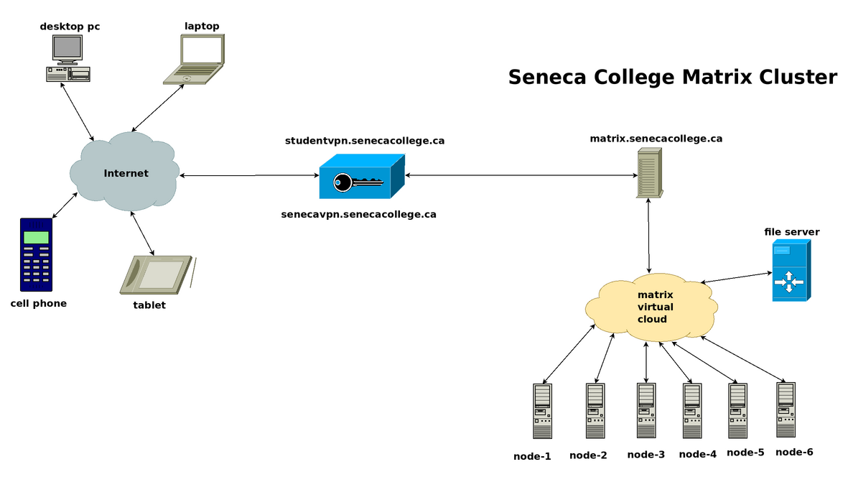
Matrix Linux Server
The Matrix server consists of several Virtual Computers connected to form a cluster. A cluster is a cost effective alternative to buying larger servers.
All registered students in this course have access to an account on the Matrix server. You will be using this account for the following reasons:
Issuing Linux commands
Practicing Linux commands at the Linux shell to be more productive
Performing Linux Online Tutorials (11)
Practice Issuing Linux Command Review Questions
Performing Linux Online Review (2)

Slide 20
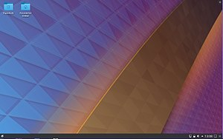
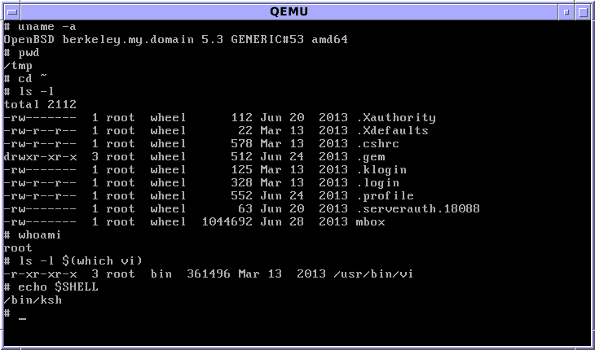
Matrix Linux Server
Communicating with Matrix Server
In UNIX / LINUX, a shell refers to an interface that allows a user to communicate with the OS.
UNIX / LINUX has the ability to install a GUI (Graphical User Interface) that allows the user to launch applications via icons, graphically manage files, etc.
On the other hand, due to bandwidth issues and the large number of Seneca students that remotely connect to the Matrix server, it is NOT feasible to connect via a GUI.
Therefore, it is only possible to interface with your Matrix account via a CLI (Command Line Interface), where students issue Linux commands to launch applications, manage files, etc...

Slide 21
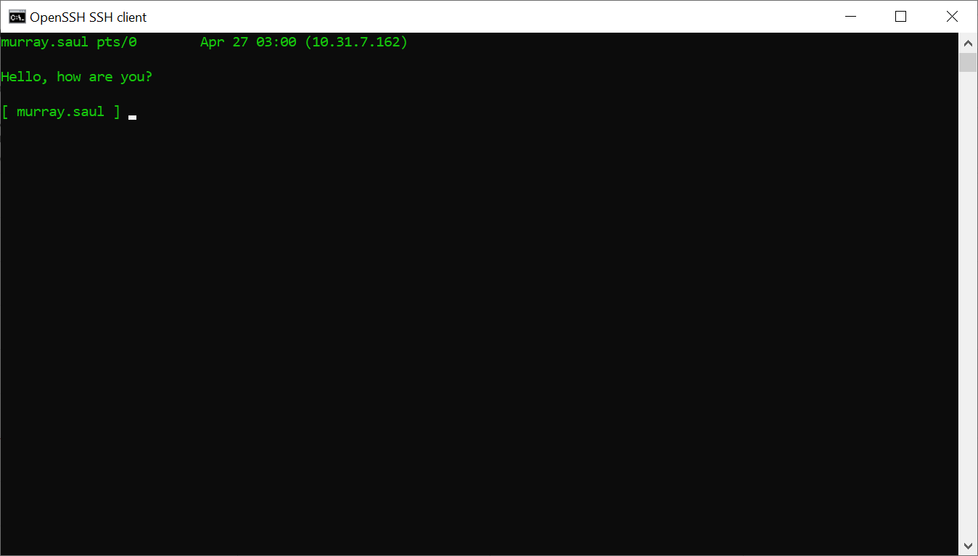
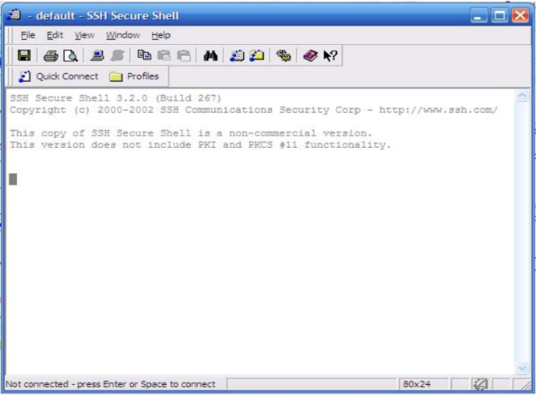
Matrix Linux Server
Accessing Matrix from your Home Computer:
Based on the type of course delivery method, students may be required to learn remotely or a hybrid method of remote and in-class instruction.
Students have an option to connect to their Matrix accounts via command-line (eg. ssh command) or by running in the Seneca computer lab a graphical SSH application (eg. SSH Secure Shell Client).
ssh command in command prompt
ssh graphical application in MS Windows

Slide 22
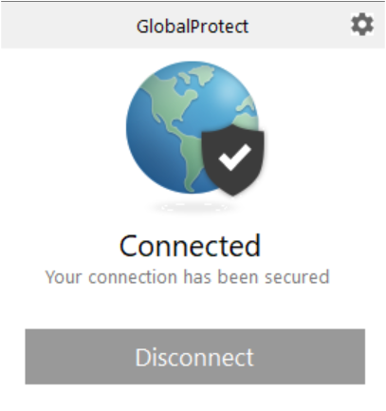
Matrix Linux Server
Connecting to the Seneca GlobalProtect Student VPN As of September 2020, all Seneca College students are required to FIRST connect to the Seneca GlobalProtect Student VPN in order to be able to connect remotely to their Matrix Linux account. Seneca College are "rolling-out" additional measures to improve network security. One of these measures are to implement multi-factored authentication.
Multi-factor authentication is an electronic authentication method in which a computer user is granted access to a website or application only after successfully presenting two or more pieces of evidence (or factors) to an authentication mechanism: knowledge (something the user and only the user knows). Reference: https://en.wikipedia.org/wiki/Multi-factor_authentication NOTE: If you haven't done this yet, please perform the steps provided in the following link: https://students.senecacollege.ca/spaces/186/it-services/wiki/view/1025/student-vpn

Slide 23
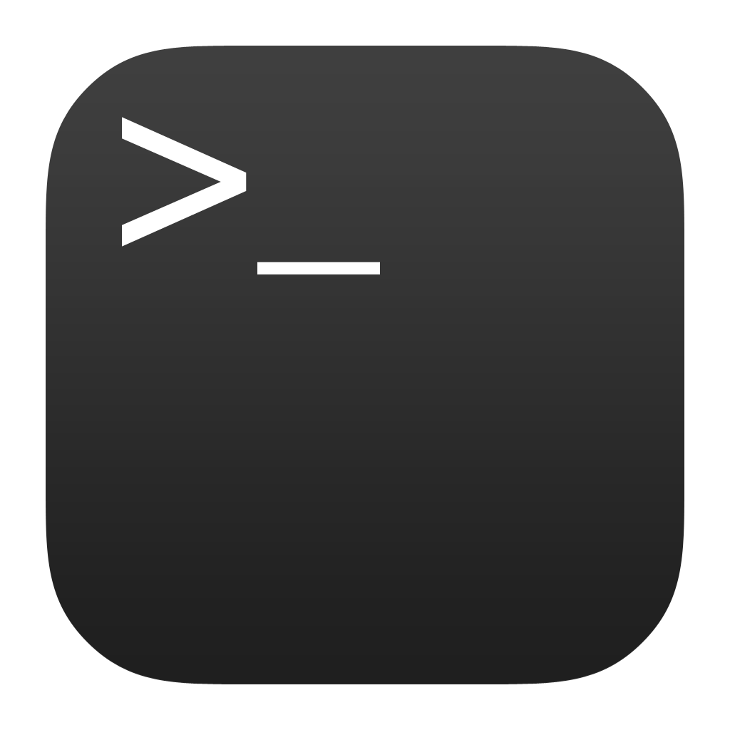

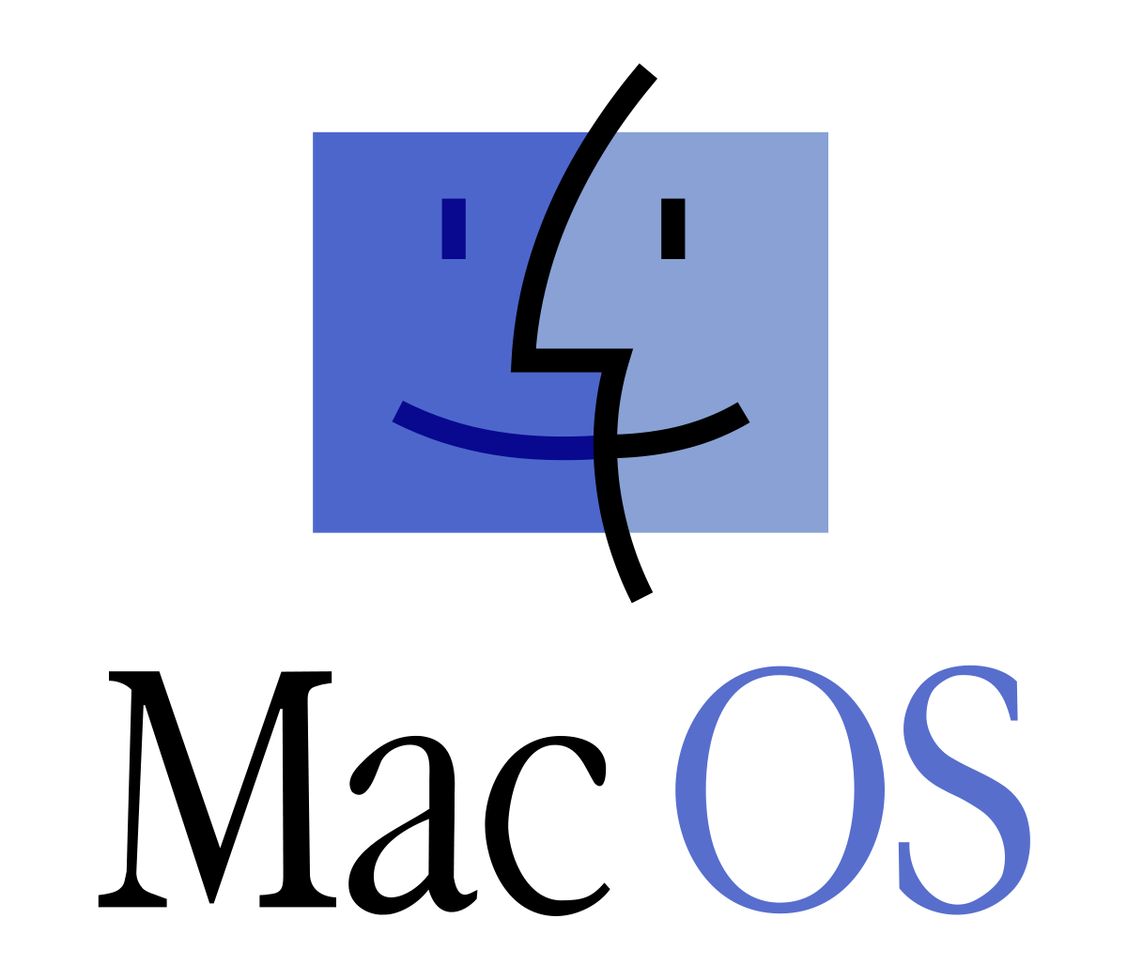
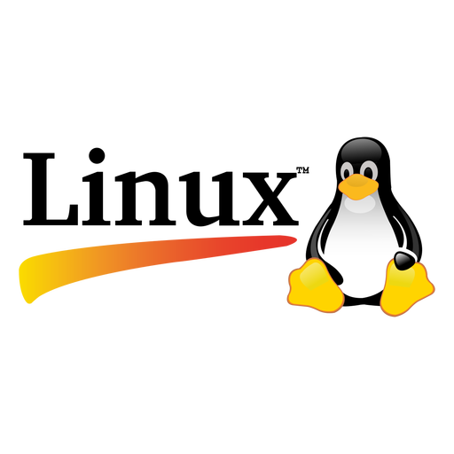
Matrix Linux Server
Accessing Matrix Using SSH on Windows 10, Mac OSX or Linux:
Open a terminal on Windows 10
From the start menu, type cmd and click on cmd icon to launch.
Open a terminal in macOS
Open Finder, go to Applications > Utilities, and click on the Terminal icon.
Open a terminal in Linux
From the main menu, choose Applications > System Tools > Terminal
NOTE: Regardless of the operating systems, in the command line:
Enter the following command: ssh senecausername@matrix.senecacollege.ca
Enter your password when prompted. (Answer yes to any questions it may ask you.)

Slide 24
Matrix Linux Server
Accessing Your Matrix Account / Continued…
Your Matrix username and password is identical to your myseneca username and password. If you were located outside Seneca's network, then you would need to enter the full domain name: matrix.senecacollege.ca
If this is the first time that you are connecting to your Matrix account, you will be prompted to share your public key. This will allow your interaction between your Matrix account and your remote computer encrypted for additional security. Simply type yes and press ENTER
NOTE: When using the ssh command, as you type your password, the characters do NOT echo back (e.g. Like showing “dots”). That is normal for this command and just continue entering your password.
NOTE: If you encounter an error message, this can occur for several reasons:
You mis-spelled the name of the server
You mis-spelled your Matrix username (same username that you connect to my.senecacollege.ca)
You have CAPS LOCK on by mistake (your username should be lowercase only).
You mis-spelled your password (same password that you connect to my.senecacollege.ca)
If you continue to experience the same problems, click on the following link for IT service desk contact info: IT service desk

Slide 25

Matrix Linux Server
Logging Out of Your Matrix Linux Account:
When you want to log-out of your Matrix server account, you can enter the commands exit, logout, or press the shortcut key: <ctrl><d>
NOTE: You should exit by issuing a command or shortcut key as opposed to closing the SSH application window.

Slide 26
Matrix Linux Server
Instructor Demonstration:
Your instructor will demonstrate how to connect to the Matrix server by issuing a command from the OS command prompt on your home computer.

Slide 27
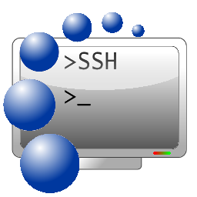
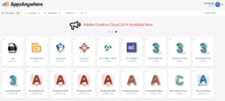
Matrix Linux Server
Accessing Matrix in Seneca Computer lab (via MyApps)
You can also connect to your Matrix server account in the Seneca Computer lab via MyApps.
One advantage of this method is that your are at the college; therefore, you do NOT have to worry about connecting to the Seneca VPN. Another advantage of using this method is to introduce you to a graphical program to allow you connect to your Matrix account as opposed to using the ssh command (shown in the previous section).
This method would also be useful if you do not have a home (notebook) computer and have access to a Seneca computer lab workstation.

Slide 28
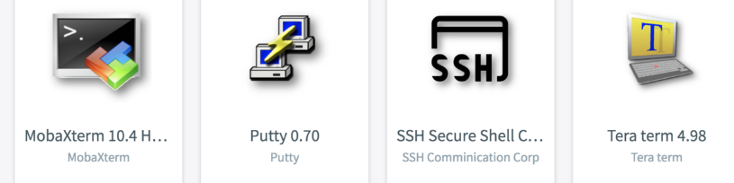
Matrix Linux Server
Accessing Matrix in Seneca Computer lab (via MyApps) / Cont….
Perform the Following Steps:
Start your workstation in your lab and login to your Seneca Windows account.
Make certain that the MyApps window is open. This window should have opened shortly after you logged into your Windows workstation. If the application windows is not open, click on the MyApps icon on the desktop to launch). NOTE: If a banner appears at the top labelled “Requires Validation”, click the banner and use your username and password.
Click on the Search Apps area located in the top right corner of the MyApps window and type the word: ssh
Several SSH applications will appear. NOTE: All of these applications allow you to connect to your Matrix account. We will use the application called SSH Secure Shell Client for this practice tutorial.
Launch the SSH Secure Shell Client application icon to launch this program.
NOTE: Prior to launching the application, you can add this to your favourites which will make it faster to access this application in the future.

Slide 29

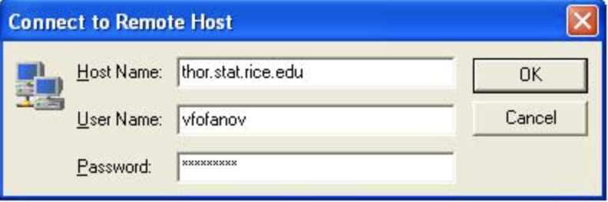
Matrix Linux Server
Accessing Matrix in Seneca Computer lab (via MyApps) / Cont….
Perform the Following Steps:
The main SSH Client window will appear. Click on the Quick Connect button. NOTE: The Connect dialog box allows the user to specify the server name and your account name to allow you to connect to the server.
Click on the textbox labelled Hostnanme and enter the text: matrix NOTE: You can use the hostname matrix since you are located inside Seneca's network. If you where located outside Seneca's network, then you would need to enter the full domain name: matrix.senecac.on.ca
Follow the same steps discussed in previous slides to connect and then disconnect to your Matrix account.

Slide 30
Matrix Linux Server
Instructor Demonstration:
Your instructor will demonstrate how to connect to the Matrix server running an SSH application via MyApps in a Seneca computer lab.
NOTE: If your professor does not have a face-to-face class, but you have access to Seneca computer labs, then perform this method in online tutorial 1. Later in the course, your instructor may demonstrate other ways of accessing your Matrix account by launching a graphical versions of Linux and run ssh command from the Linux shell.

Slide 31

HOMEWORK
Get Acquainted with the ULI101 WIKI, notes, tutorials and resources.
Perform the following investigations in Tutorial 1 (Due: Friday Week 2 @ midnight for a 2% grade): INVESTIGATION 1: ACCESSING YOUR MATRIX LINUX ACCOUNT

